Slide 1
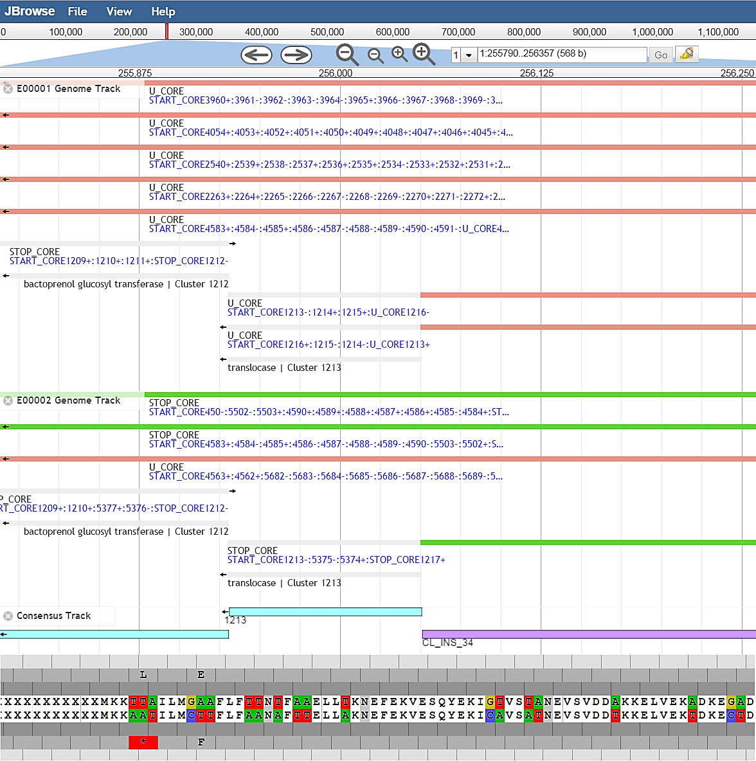
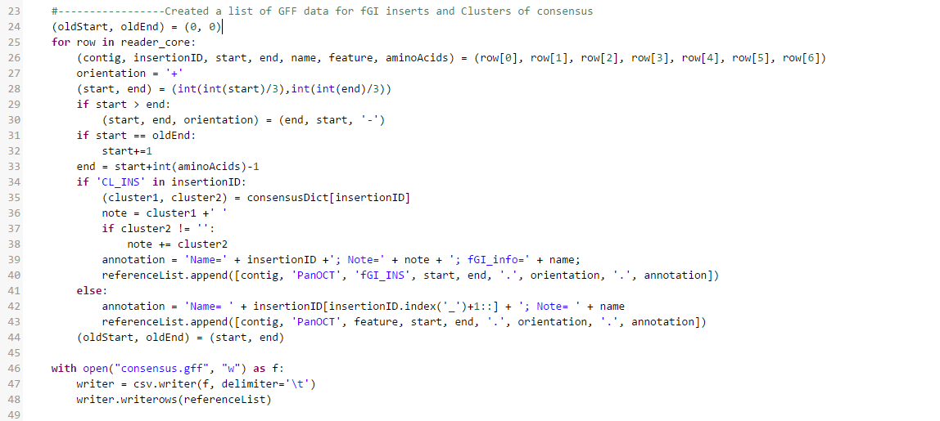

PanGenome Visualization with JBrowse
Namita Dongre, Anika Verma, Indresh Singh
Informatics Department, J. Craig Venter Institute, Rockville, MD 20850
Abstract
The objective of this project was to visually compare genome variations to a single consensus using a genome browser. Our biological data came from the Enterobacter cloacae, strain 34977 and was based on the pan-genomic analysis done by pan-genome ortholog clustering tool (PanOCT) and three other commonly used ortholog-detection methods. Our consensus track contained the 70% common clusters present in the various genomes of E. cloacae. We created GFF-file format tracks for the consensus and individual genomes with Python and imported them into JBrowse, a JavaScript-based genome browser. We also prepared a reference sequence FASTA file which contained sequence data for the consensus track. Our JBrowse customizations allow users to easily view and compare clusters, flexible genome island (fGI) inserts, and other special features present in the consensus and genome variants.
Methods
Preparing Reference FASTA file
Sequence data was taken from the centroids.fasta file which listed core clusters and their corresponding genes and sequences. Sequences of core clusters present on the same contig were concatenated and listed under that contig on the FASTA file. Sequences for insertions and non-core clusters were substituted with X’s. Features not represented by centroid.fasta were placed in a “Missing” contig. Python was used to prepare the reference sequence FASTA file. The following script from the JCVI Araport project was used to process the file:
Preparing Consensus Track file
Consensus track data such as coordinates, contigs, clusters, and annotations were taken from the Core.att_fgi file. The consensus track contains two features: fGI insertions (fgi_INS) and core clusters (CL). Python was used to prepare the consensus GFF track file. The following script from the JCVI Araport project was used to process the file:
Preparing Genome Track file
Individual genome track data came from the combined_att.file, panoct.results, and fgi_stats.details. The combined_att.file file provided the genes present in each genome. The panoct.results file mapped the clusters associated with each gene per genome. The fgi_stats.details file provided the fGI insertion data for each genome. The individual genome tracks contained four features, U_CORE, STOP_CORE, Gene, and Break, and two subfeatures to display the fGI insertions, fgi_u and fgi_s. Python was used to prepare the individual genome GFF tracks. The following script from the JCVI Araport project was used to process the file:
Customizing Tracks
Track customization was done by editing the trackList.json file for the JBrowse tracks. The feature tracks were all designed with HTMLFeatures for best representation.
Background
Pan-genome analysis is the process of comparing protein content in order to identify the differences between strains. However to find the differences between the strains, one must find the identical proteins throughout them. The easiest way to find these proteins is to find the orthologous clusters. We used pan-genomic analysis for this project to identify the orthologous clusters within the bacterium Enterobacter cloacae.
Figure 2. The topmost track with the red, clear, and green clusters are part of the E00001 Genome Track. U_CORE is represented in the light red, STOP_CORE is represented in green, and Genes are colorless. The same data is represented in the E00002 Track below. The track below that is the Consensus track, which contains CL’s and fGI inserts. The CL’s are represented in blue, and the fGI inserts are represnted in purple. Below that is the reference sequence.
Introduction
The goal of this project was to visualize Pan-Genome Analysis using a genome browser. Ten Enterobacter cloacae strains were used as a pilot project. Genome browser will allow researcher to compare, interact and probe different fGIs, genes, features or regions of interest.
Challenges
While the cluster coordinates provided in the data were with respect to the nucleotide level, the reference sequence data were with respect to the peptide level. To account for this discrepancy, we divided the coordinates by 3 to match the sequence with the clusters.
The reference sequence represented the core clusters present in the consensus. Genomes contained clusters that are not present in consensus core genome, non consensus clusters were listed in “missing” consensus contig. Ambiguous Amino Acid code “X” was used to represent inserts and non core clusters.
Some of the U_CORE features existed across multiple contigs due to the circular nature of the E. cloacae strain. Since JBrowse only supports a linear view, we listed the other contigs IDs in track details.
Results
With JBrowse, we created a clear visual way to compare clusters, insertions, and other special features of the genomes and consensus.
Funding
This project has been funded in whole or part with funds from J. Craig Venter Institute, National Institute of Allergy and Infectious Diseases, National Institutes of Health, Department of Health and Human Services under Award Number U19AI110819.
Future Directions
In the future, we hope to add more customization to feature tracks such as icons for insertions and make it easier for the user to play around with the track colors. Additionally, we hope to take care of the data discrepancies mentioned above such as more accurate nucleotide to peptide-level coordinate conversion and perhaps finding a genome browser to retain the circular properties of the DNA of E. cloacae and other bacteria. We also hope to add functionality to allow users to sort genome tracks by various criteria.
Acknowledgements and References
Fouts, D. E., Brinkac, L., Beck, E., Inman, J., & Sutton, G. (2012). PanOCT: automated clustering of orthologs using conserved gene neighborhood for pan-genomic analysis of bacterial strains and closely related species. Nucleic Acids Research, 240(22).
Thank you to Granger Sutton, Derrick Fouts, and Maria Kim for your assistance in this project.
https://github.com/jcvi-software/PanGenomeVisualization
Figure 1. A screenshot of our code in the consensusTrackCreate.py file. This creates the consensus (in gff format) file.

