Slide 1

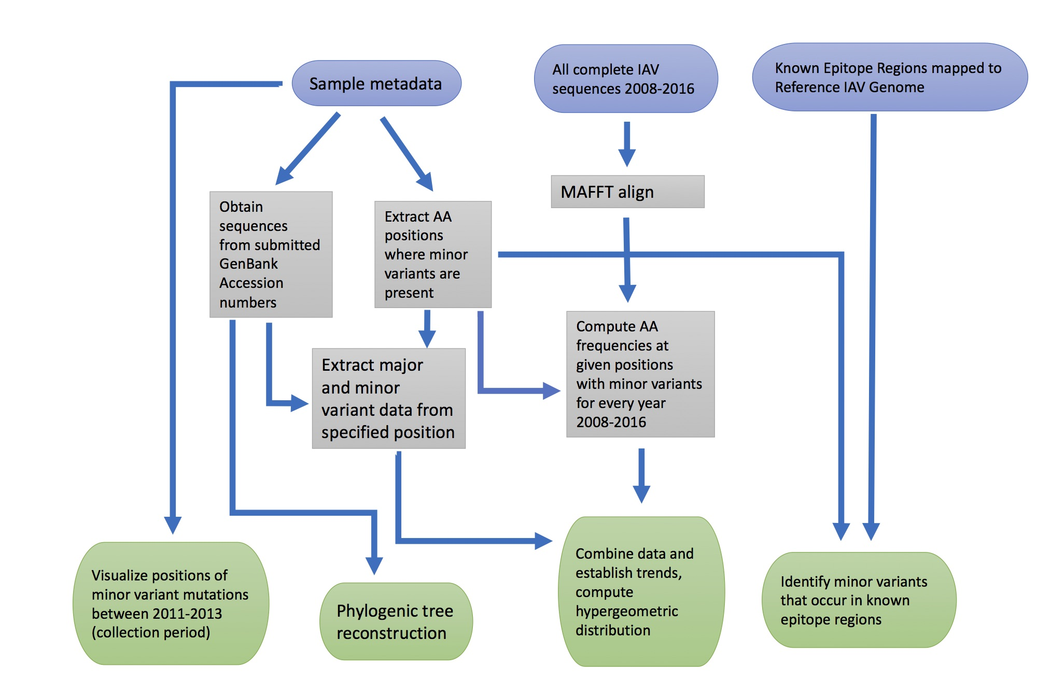
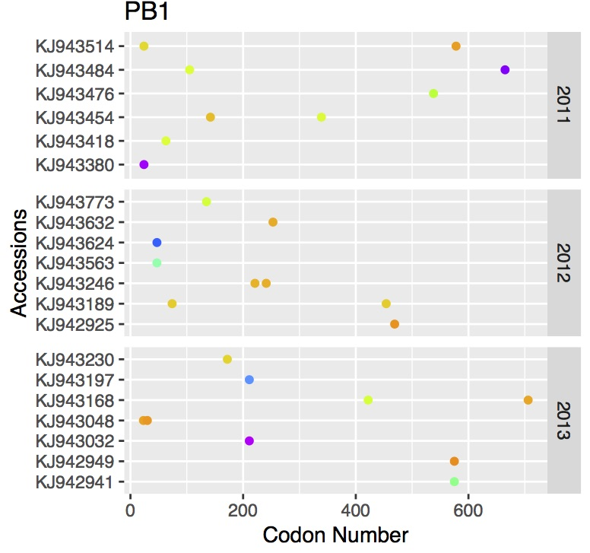
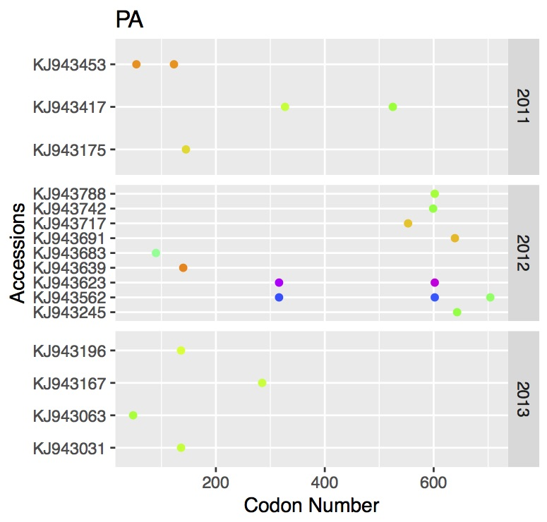
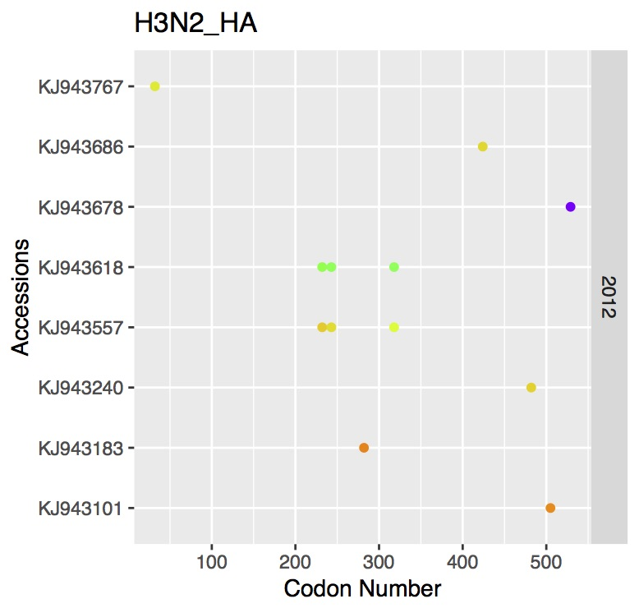
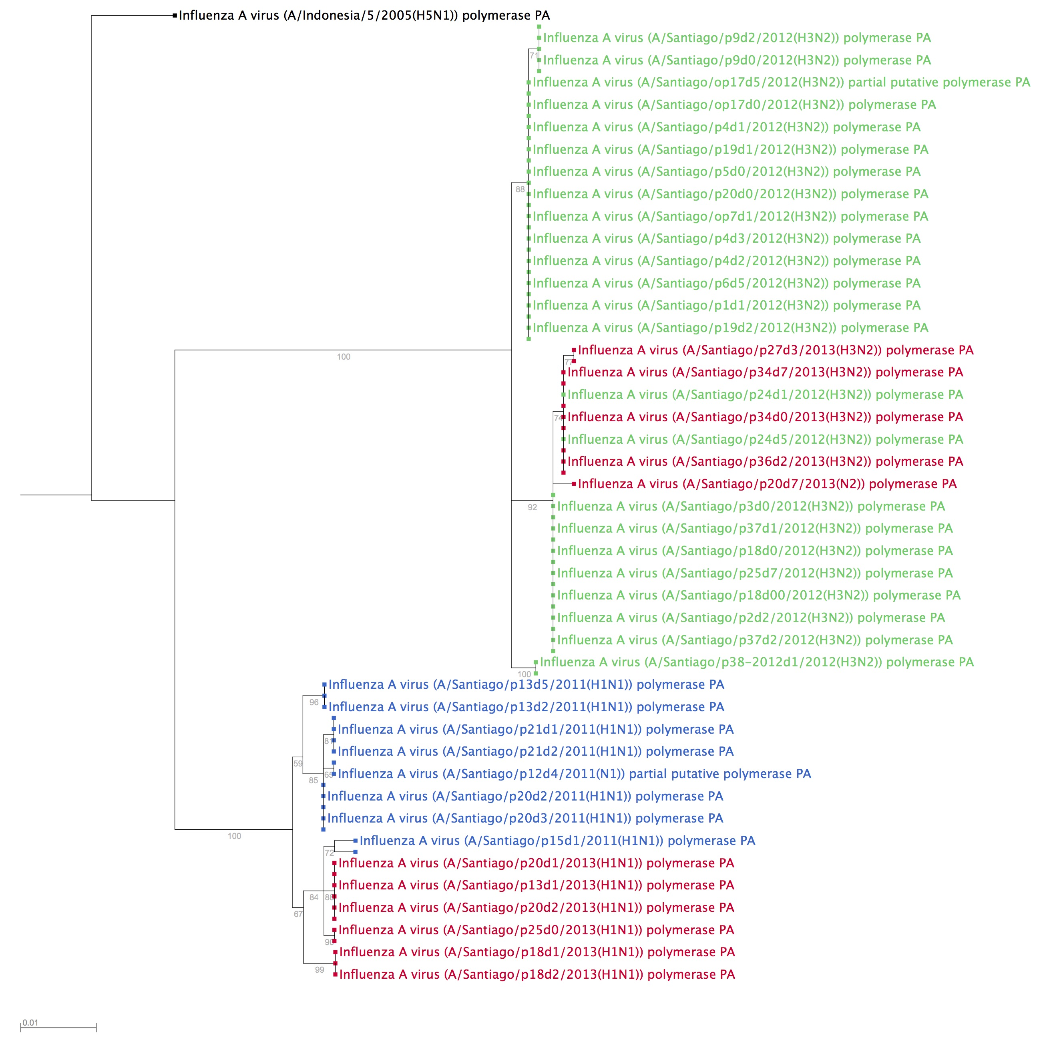
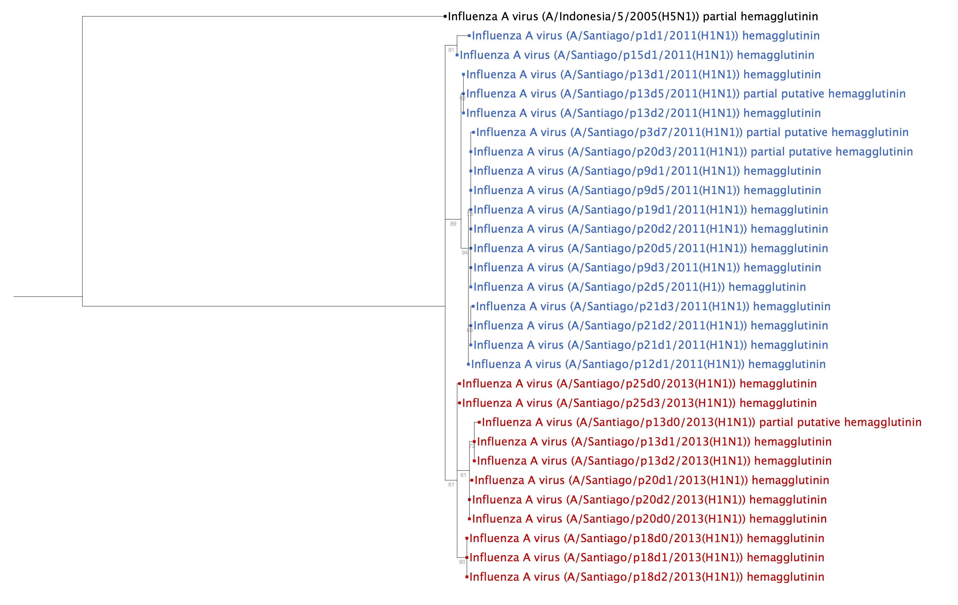
Everybody is Kung-Flu Fighting: Deep Sequencing of Clinical Influenza A virus Reveals Patterns of Emerging/ Re-emerging Amino Acid Substitutions
Emma Roth¹, Brian Aevermann¹, Vinita Puri², Nadia Fedorova², Susmita Shrivastava², Lihui Wu, Paolo Amedeo², Rafael Medina³, Gene Tan¹, Brett E. Pickett¹
¹J. Craig Venter Institute, La Jolla, California, USA, ²J. Craig Venter Institute, Rockville, Maryland, USA, ³Pontifical Catholic University of Chile
Abstract
Infection by influenza A virus (IAV) can occur in humans, birds, or swine and results in approximately 700,000 hospitalizations and 56,000 human deaths each year. Although vaccines exist and are reformulated each year, the rapid mutation rates (antigenic drift) and reassortment (antigenic shift) across the viral subtypes make it difficult to consistently prevent or treat infection. In this study, we examined deep sequencing data of IAV samples collected between 2011-2013 from Santiago, Chile to determine whether amino acid substitutions that are emerging/re-emerging at the global scale could be identified by observing minor variants in the genomes isolated from multiple patients. To do so, we created a workflow that visualizes the locations of minor variants across each segment for these genomes, calculates mutations that stray from the consensus amino acid in that location across all GenBank sequence records for each year, and determines whether the codons that contain a minor variant are located in known epitope regions from a reference genome. Phylogenetic tree reconstruction reveals that the sequences lie within the expected topology of influenza and cluster primarily by year of isolation. Patterns identified in this analysis have the potential to improve our understanding of the viral response to immune pressures within its host, and to detect any substitutions that change immune epitopes to increase virus fitness. Overall, these results can be applied at a larger scale to sequences of future epidemic strains and potentially improve the efficacy of the influenza vaccine.
Figure 3: Visualization of codons containing minor variants for representative segments revealed potential patterns of mutation within the dataset collected from Chile.
Table 1: Subset of data produced by minor variant analysis. Frequency columns refer to frequencies calculated at the global level from all hosts. (*) denotes the first year the minor variant appeared in humans. Row colors indicate category of substitution in humans.
Background
Figure 1: Graphical depiction of the bioinformatics workflow that was used.
Protein | Isolation Year | Obs. Minor Var. | '08 Freq | '09 Freq | '10 Freq | '11 Freq | '12 Freq | '13 Freq | '14 Freq | '15 Freq | '16 Freq | % Minor Var | Epitope
HA-H1N1 | 2013 | N52D | *D:161; N:399 | D:6990; N:545 | D:1896; N:159 | D:1636; N:216 | D:917; N:323 | D:1427; N:310 | D:1032; N:293 | D:910; N:327 | D:2509; N:224 | 20.7 | Y
HA-H1N1 | 2011 | K189E | E:136; *K:4 | E:7037; K:23 | E:1904; K:35 | E:1575; K:13 | E:1076; K:25 | E:1520; K:35 | E:1118; K:18 | E:836; K:4 | E:2390 | 8.95 | Y
HA-H3N2 | 2012 | D424N | D:468; N:6 | D:959 | D:1071; *N:6 | D:1380; N:2 | N:5; D:1968 | N:6; D:1549 | D:2359; N:6 | D:2489; N:4 | N:7; D:2411 | 8.87 | Y
HA-H3N2 | 2012 | D529N | D:466; N:2 | D:959 | D:1084; N:1 | D:1381; N:2 | D:1966; N:6 | D:1543; N:5 | D:2361 | D:2490; N:3 | D:2408; N:10 | 41.3 | N
M1 | 2012 | I115V | I:834; V:1378 | I:1033; V:6669 | I:656; V:3098 | I:713; V:3102 | I:1189; V:2492 | I:922; V:3337 | I:1069; V:2878 | I:1491; V:2343 | I:1800; V:2598 | 19.52 | --
M2 | 2013 | L63P | P:1993 | P:6980 | P:3396; L:1 | P:3387 | P:3451 | *P:4120 | L:1; P:3808 | P:3707; L:3 | P:4264; L:1 | 8.06 | --
NA-H1N1 | 2011 | A86T | A:593; *T:19 | A:6140; T:36 | A:1726; T:16 | A:1390; T:12 | A:902; T:31 | A:1096; T:25 | A:867; T:18 | A:776; T:42 | A:1926; T:50 | 7.41 | Y
NA-H3N2 | 2012 | Q49H | H:6 Q:699 | H:6; Q:1089 | H:3; Q:1215 | *H:17; Q:1917 | H:3; Q:2144 | H:1; Q:1981 | H:23; Q:1924 | H:172; Q:2224 | Q:2276; H:149 | 7.38 | Y
NA-H3N2 | 2012 | M51V | M:507; *V:186 | M:838; V:228 | M:959; V:215 | M:1537; V:251 | M:1864; V:238 | M:1706; V:221 | M:159; V:260 | M:2066; V:217 | M:1724; V:486 | 5.05 | Y
NA-H3N2 | 2012 | S219F | S:670 | S:1042 | S:1163 | S:1862 | S:2068 | S:1656; | S:1828 | S:2379 | S:2414 | 5.03 | N
NEP | 2013 | H85Q | H:1444;Q:3 | H:5909; *Q:8 | H:2661; Q:9 | H:2688; Q:6 | H:2358; Q:2 | H:2913; Q:4 | H:2645; Q:3 | H:2676; Q:3 | H:3902; Q:7 | 40.63 | --
NEP | 2012 | E75K | K:1; E:1746 | E:6357 | E:2994 | E:2951 | E:2553 | K:1; E:3080 | E:2795 | E:2826 | E:3957 | 6.97 | --
NP | 2013 | N125D | D:2; N:1739 | *D:6; N:6745 | D:16; N:2914 | D:1; N:2901 | N:2518 | D:1; N:3088 | D:4; N:2744 | D:1; N:2844 | N:3963 | 15.67 | --
NP | 2013 | R461K | R:1733 | K:6; R:6728 | *K:3; R:2900 | K:3; R:2867 | K:1; R:2559 | R:3076 | K:8; R:2733 | K:14; R:2844 | K:4; R:3962 | 17.99 | --
NS1 | 2012 | R37H | H:3; R:1759 | H:1; R:6355 | H:1; R:3001 | R:2952 | R:2560 | *H:1; R:3074 | H:1; R:2798 | R:2823 | R:3955 | 16.48 | --
PA | 2012 | V90I | *I:5; V:1788 | I:6; V:6125 | I:8; V:2795 | I:10; V:2718 | I:14; V:2442 | I:5; V:2933 | I:3; V:2623 | I:22; V:2708 | I:11; V:3850 | 23.68 | --
PA | 2011 | E327G | E:1758; G:5 | E:6123; *G:8 | E:2767; G:15 | E:2710; G:7 | E:2394; G:7 | E:2853; G:9 | E:2381; G:5 | E:2552; G:4 | E:3848; G:3 | 12.82 | --
PB1 | 2013 | Y30H | Y:1753; H:2 | H:1; Y:5896 | Y:2771; H:1 | Y:2682; H:1 | Y:2396 | Y:2919; *H:4 | Y:2633; H:3 | Y:2733; H:6 | Y:3779; H:1 | 5.52 | --
PB1 | 2011 | N105S | S:5; N:1746 | *S:5; N:5890 | N:2751; S:13 | S:3; N:2663 | S:6; N:2354 | N:2901; S:5 | N:2601 | S:3; N:2726 | S:6; N:3767 | 11.04 | --
PB2 | 2011 | V255I | *I:74; V:1534 | I:66; V:5794 | I:322; V:2463 | I:297; V:2401 | I:268; V:2152 | I:97; V:2827 | I:78; V:2467 | I:38; V:2644 | I:156; V:3693 | 5.4 | --
Influenza A virus (IAV) consists of 8 single-stranded negative-sense RNA segments that encode 10 core proteins, most notably the surface glycoproteins hemagglutinin (responsible for cell binding and entry) and neuraminidase (responsible for virus escape from the infected cell). RNA viruses like IAV have higher mutation rates than DNA-based viruses because the RNA-dependent RNA polymerase lacks the proofreading mechanisms that DNA polymerases possess. Antigenic shift and drift can result in resistance to antiviral drugs and ineffective vaccines. In addition, a subset of these mutations can allow a virus to bypass the immune response of an individual who developed immunity to a previous virus strain. Similar changes can also result in different (potentially more severe) virulence characteristics and the ability to infect new hosts. Previous studies have examined minor variants within an individual as well as within a well-defined community at a particular time point. This study attempts to determine the extent to which the frequencies of minor variants identified in a localized human population over time correlate with observed IAV mutations on a global level.
Results
Figure 2: Sample phylogenic reconstruction of sequences from dataset isolated in 2011, 2012, and 2013 revealing by-year clusters. A/Indonesia /5/2005/(H5N1) is used as an outgroup in this analysis.
A. Maximum likelihood tree bootstrapped with 100 replicates, consisting of all PA segments from the dataset.
B. Maximum likelihood tree bootstrapped with 100 replicates, consisting of HA segments from H1N1 subtypes present in our dataset.
A
Already in majority
Emerging, low frequency
Emerging, high frequency
Re-emerging, low frequency
Never emerges
Data and Methods
Sequencing data was generated using Illumina MiSeq (2x300bp reads) and assembled using CLC Bio software. Minor variants were identified with a custom script that removed detected variants that were below 3% prevalence across all reads at any position, and a corrected p-value of 0.05 using a binomial distribution. Visualization of the position in each transcript and % prevalence of minor variants were visualized at the transcript level using a custom script. The translated protein sequence for each of the of the samples in the dataset were extracted from GenBank (https://www.ncbi.nlm.nih.gov/genbank/), grouped by shared transcript and year, and aligned with MAFFT (http://mafft.cbrc.jp/alignment/software/). Bootstrapped maximum likelihood phylogenetic trees were generated with RAxML (https://sco.h-its.org/exelixis/web/software/raxml/index.html) for each of the alignments, which were then used to examine whether the sequences of the dataset clustered by year of isolation. Next, the Influenza Research Database (IRD) (http://fludb.org) was queried for complete protein sequences for each of the 8 Influenza A genome segments from all hosts and geographic regions during 2008-2016. The sequences from this dataset were grouped and aligned as before. A custom script was used to count the amino acid frequencies at the minor variant positions from the dataset in each of year. Positive human B-cell epitope data for the HA and NA proteins of the Influenza A virus were retrieved from the Immune Epitope Database (IEDB) (http://www.iedb.org) and were then queried to find the regions that overlapped with minor variants.
B
Conclusions
Segment-specific phylogenetic reconstruction for all sequences in our dataset showed that these sequences follow a normal evolution pattern in which samples from the same year were more similar to each other than to samples from a different year.
Comparison of minor variants in our dataset to all variants in found in IRD IAV sequences from 2008-2016 showed that PA, PB1, and PB2 were better at predicting future emerging mutations than the HA or NA segments.
Cross-referencing the positions containing minor variants in HA and NA proteins in our dataset to known B-cell epitope regions on a reference genome revealed that a majority of the minor variants in these segments are located in B-cell epitope regions.
Acknowledgements
References
I would like express my gratitude to Brett E. Pickett for his stellar mentorship throughout this project as well as his help proofreading countless poster drafts. I would also like to thank Brian Aevermann for sharing his programming expertise, and the J. Craig Venter Institute, especially Sarah Grimshaw and Yo Suzuki, for providing this opportunity to participate in such a rewarding summer internship program.
Lee AJ, Das, SR, Wang W, Fitzgerald T, Pickett BE, Aevermann BD, Topham, DF, Falsely AR, Scheuermann RH. 2015. Diversifying Selection Analysis Predicts Antigenic Evolution of 2009 Pandemic H1N1 Influenza A Virus in Humans. Journal of Virology 89:5427-5440. http://dx.doi.org/10.1128/JVI.03636-14
Noronha JM, Mengya L, Squires RB, Pickett BE, Hale BG, Air GM, Galloway SE, Takimoto T, Schmolke M, Hunt V, Klem E, García-Sastre A, McGee M, Scheuermann R. Influenza Virus Sequence Feature Variant Type Analysis: Evidence of a Role for NS1 in Influenza Virus Host Range Restriction. Journal of Virology 86: 5857-5866. http://dx.doi.org/ 10.1128/JVI.06901-11
Rolfes MA, Foppa IM, Garg S, Flannery B, Brammer L, Singleton JA, et al. Estimated Influenza Illnesses, Medical Visits, Hospitalizations, and Deaths Averted by Vaccination in the United States. https://www.cdc.gov/flu/about/disease/2015-16.htm
Fleischmann WR Jr. Viral Genetics. In: Baron S, editor. Medical Microbiology. 4th edition. Galveston (TX): University of Texas Medical Branch at Galveston; 1996. Chapter 43. Available from: https://www.ncbi.nlm.nih.gov/books/NBK8439/

